Slide 1
Hidalgo County Elections Surveyor Department Consequences & Responsibilities
Yvonne Ramón, CERa
Eberto Gauna, elections surveyor
Cindy López, elections specialist
John smith, assistant u.s. attorney

Slide 2
Hidalgo County Elections Department Background:
Total Registered Voters: 375,886 (Jan. 2, 2020)
Total Cities, school districts & other: 48
2018 Primary & General countywide Polling Locations:
2018 primary:
Early Voting: 29
Mobiles: 23
Election Day: 74
2018 general:
Early Voting: 32
Mobiles: 28
Election Day: 74

Slide 3
Hidalgo County Elections Department & U.S. Department of Justice
Compliance review of the hidalgo county elections department and the accessibility of polling places under the ada
list & map of polling places
Policies & procedures for selecting polling places
Methods of ballot casting
Curbside voting process & operation
Polling places that use temporary measures to provide accessibility & identification of specific measures used
Portable ramps
Traffic cones

Slide 4
Hidalgo County Elections Department & U.S. Department of Justice
Policies & procedures for complying with ada
Selection of polling places
Survey Tools
Methods of accommodation
Reports, summaries, documents & forms addressing polling place accessibility
Any and all complaints regarding polling place accessibility
Individual designated ada coordinator
Any other documentation relating to polling place accessibility
An opportunity for partnership

Slide 5
Why a Surveyor Department:
2016 Visit from the department of justice
Compliance review and Investigation of hidalgo county elections department and the accessibility of polling places under ada
EARLY VOTING & ELECTION DAY:
92/101 polling places surveyed by DOJ (including mobiles)
Settlement agreement between the united states of America and hidalgo county regarding accessibility of polling places

Slide 6
Surveyor Department
Mission:
Provide FULLY ACCESSIBLE POLLING LOCATIONS AND AN Impeccable VOTING EXPERIENCE FOR VOTERS WITH DISABILITIES IN HIDALGO COUNTY.

Slide 7
revise
Visit
&
Assess
develop
&
implement

Slide 8
Revise:
2016 u.s. Department of justice
Compliance review and Investigation of hidalgo county elections department and the accessibility of polling places under ada law
EARLY VOTING:
39 locations SURVEYED BY DOJ
FULLY ACCESSIBLE: 15
NOT COMPLIANT: 24
TEMPORARY REMEDIABLE: 22
STRUCTURAL CHANGES: 2
ELECTION DAY:
53 locations SURVEYED BY DOJ
FULLY ACCESSIBLE: 14
NOT COMPLIANT: 39
TEMPORARY REMEDIABLE: 35
STRUCTURAL CHANGES: 4

Slide 9
Revise:
Settlement agreement
IMPLEMENT TEMPORARY MEASURES WHERE NECESSARY TO MAKE POLLING PLACES ACCESSIBLE
CREATE A SURVEY TOOL BASED ON DOJ’s “ADA CHECKLIST FOR POLLING PLACES”
Review & survey new polling locations and give DOJ notice
Train polling location judges & clerks
Create Polling location Temporary measure compliance checklist/ paperwork for judges

Slide 10
Visit & Assess:
Polling locations
Visit:
locations addressed in report (still in use)
New locations
Possible replacements
assess:
Location updates/changes
Temporary measures
curbside

Slide 11
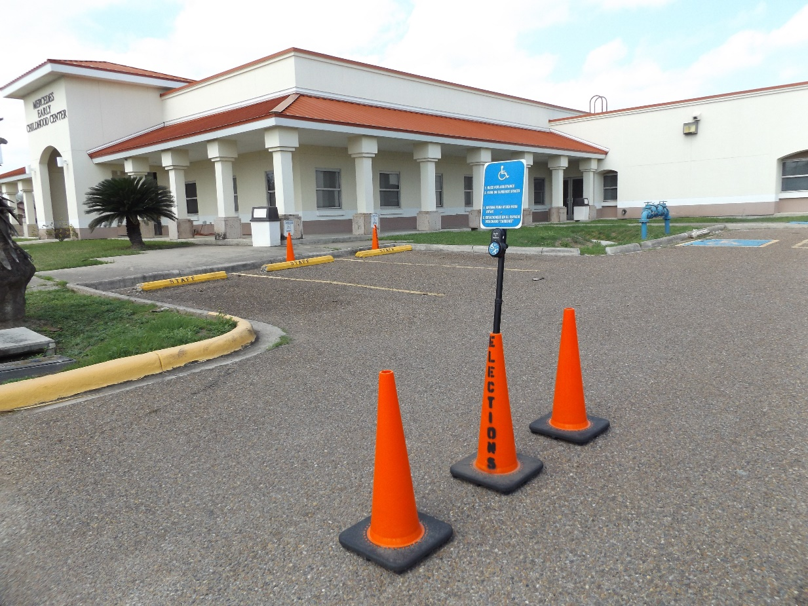
Develop & Implement:
Curbside method
buzz & park

Slide 12
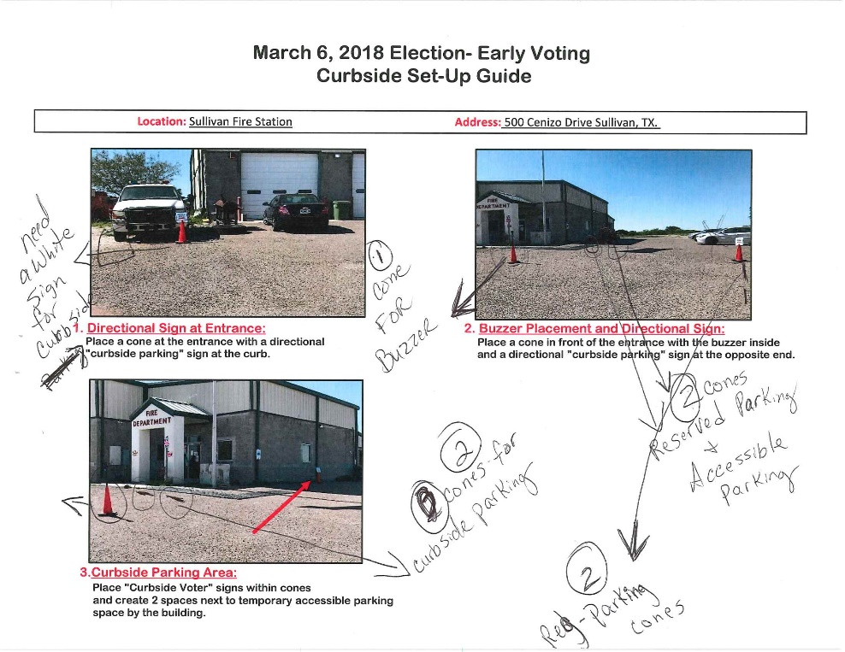
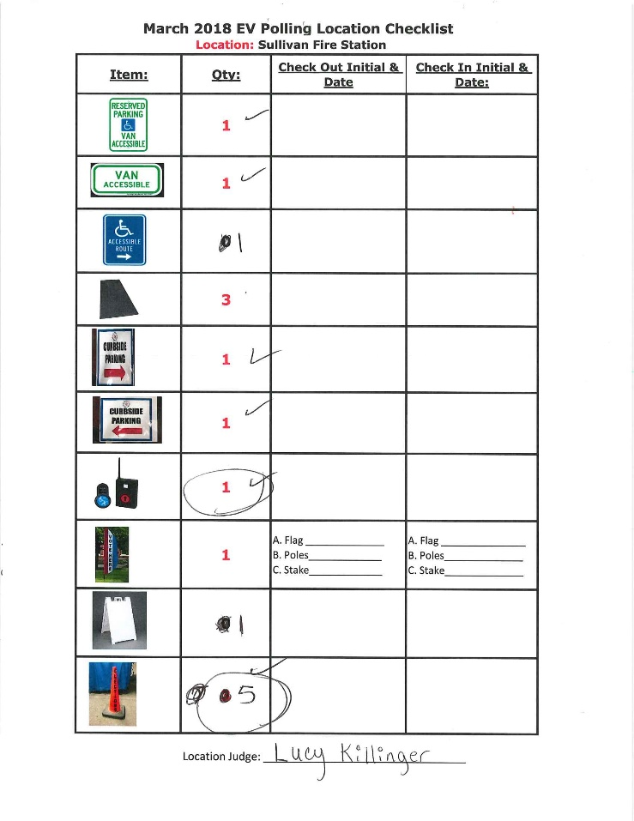
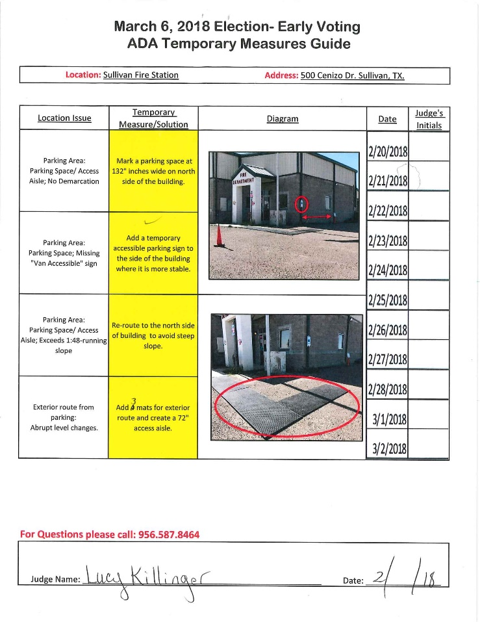
Develop & Implement:
Polling location guides
2018 primary:

Slide 13
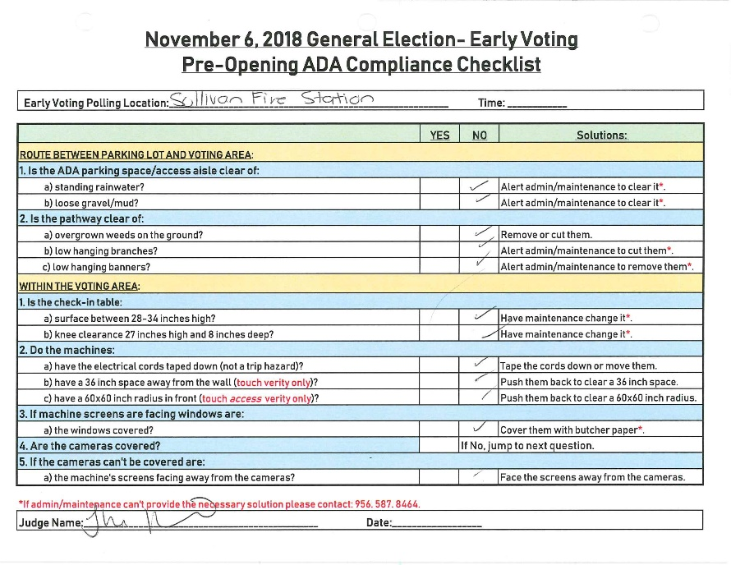
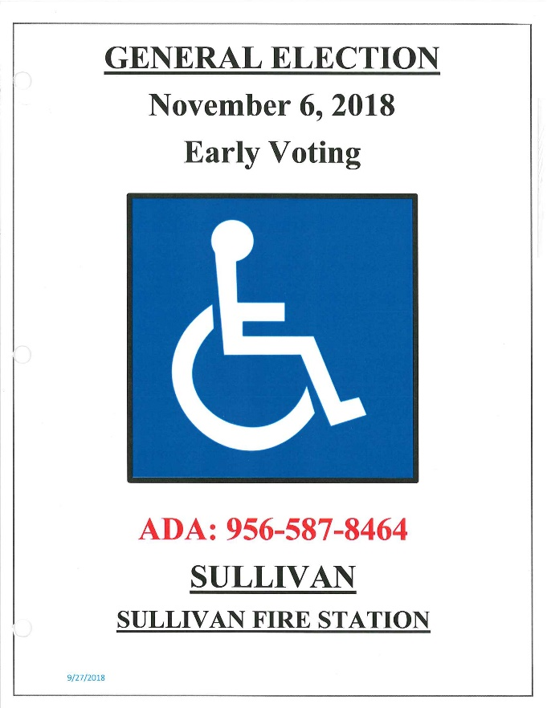
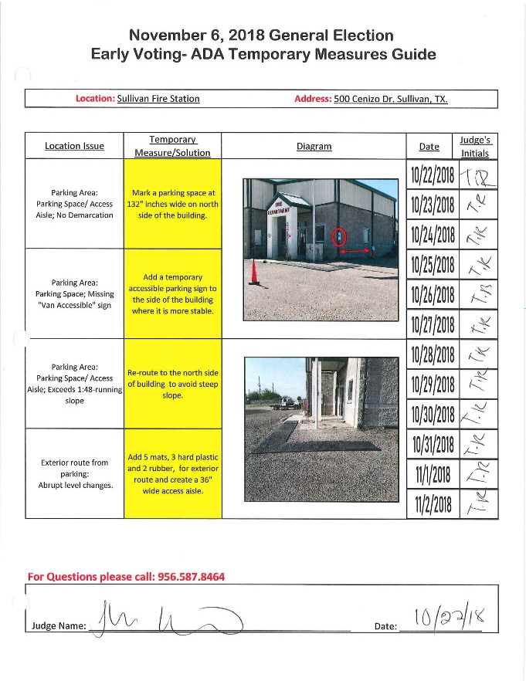
Develop & Implement:
Polling location guides
2018 general:

Slide 14
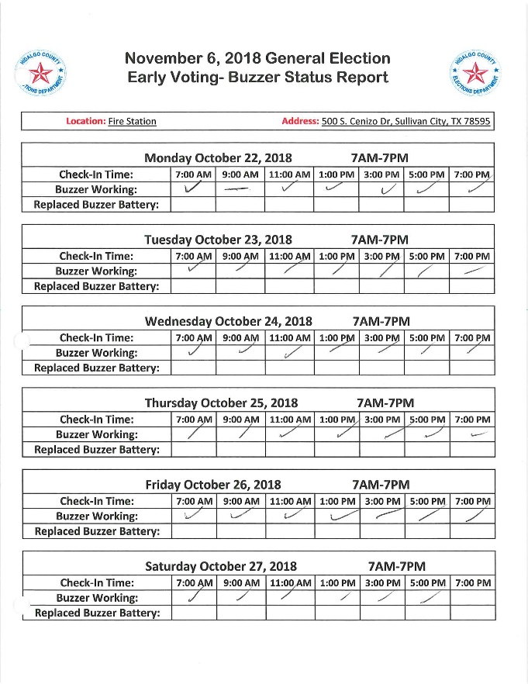
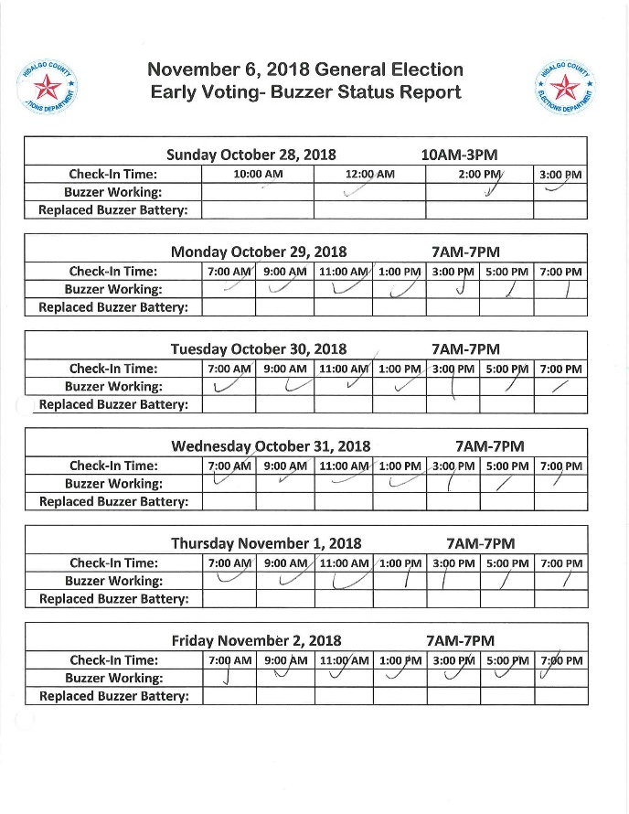
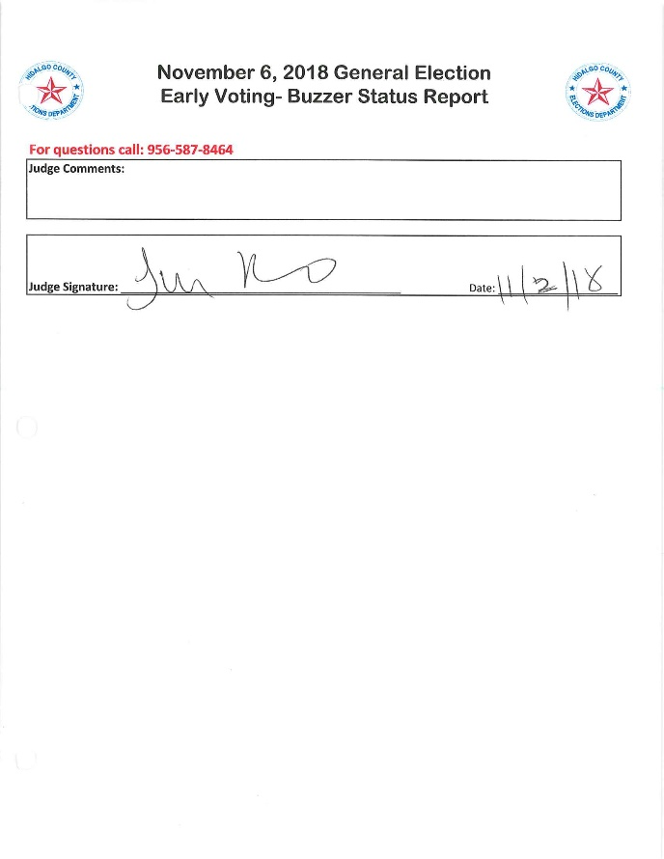
Develop & Implement:
Polling location guides
2018 general (Cont’d):

Slide 15
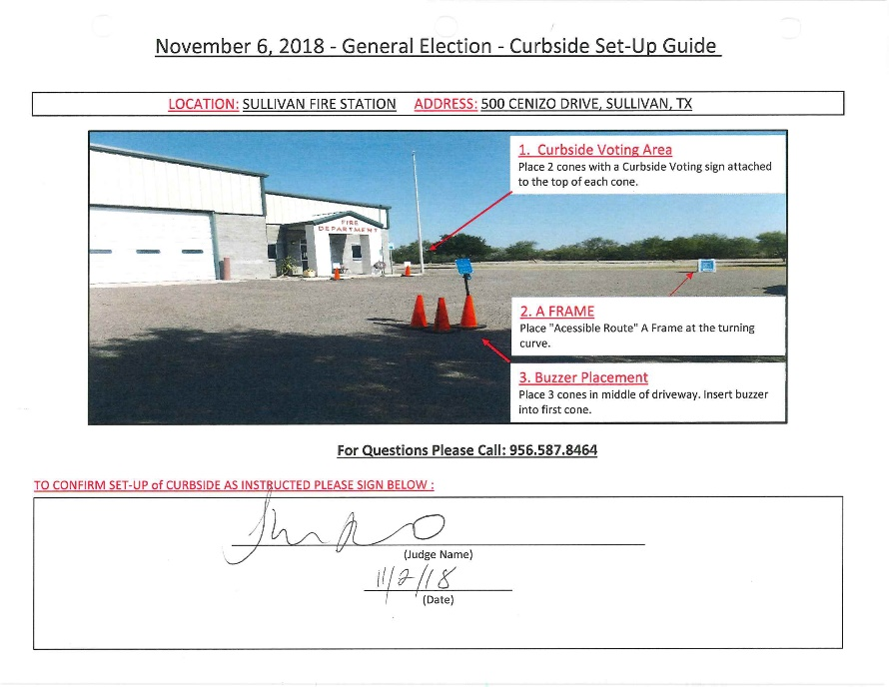
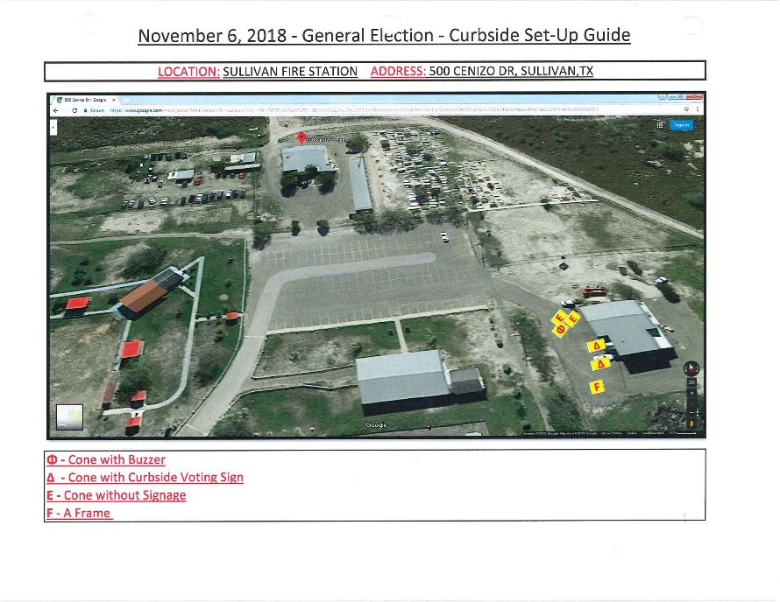
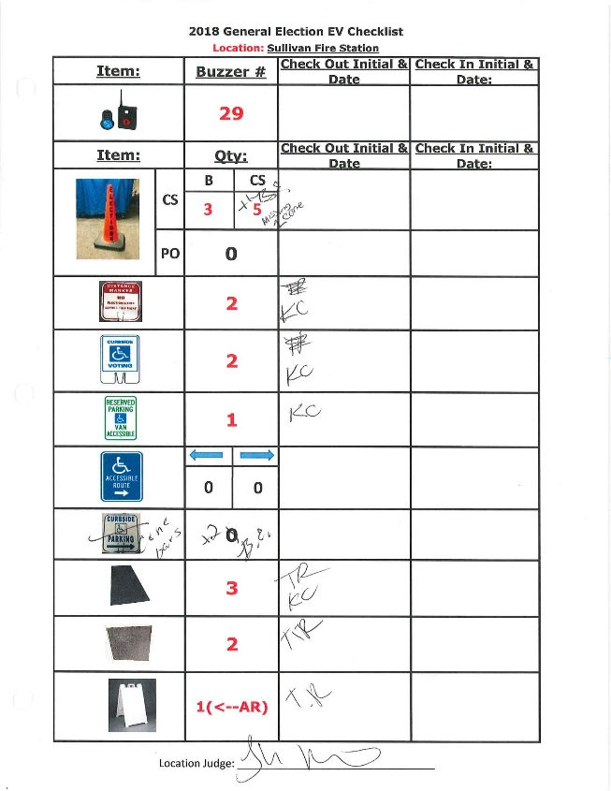
Develop & Implement:
Polling location guides
2018 general (Cont’d):

Slide 16
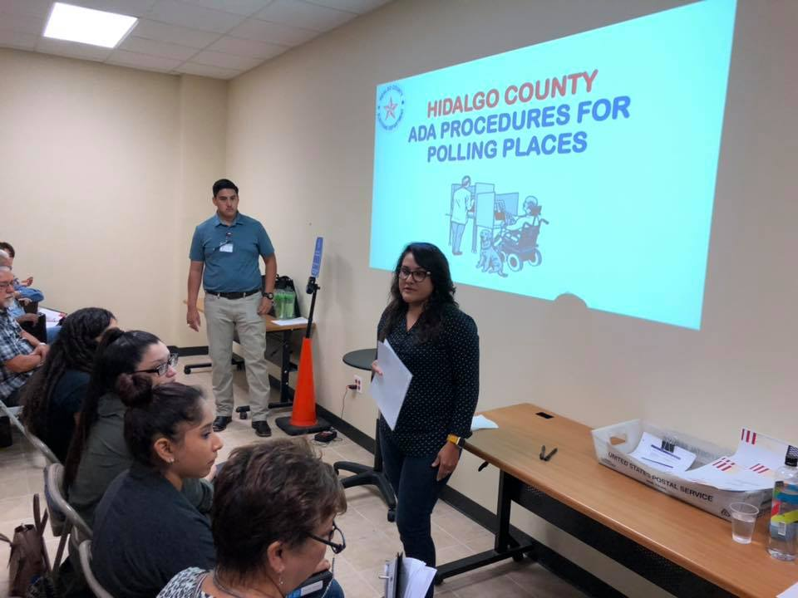
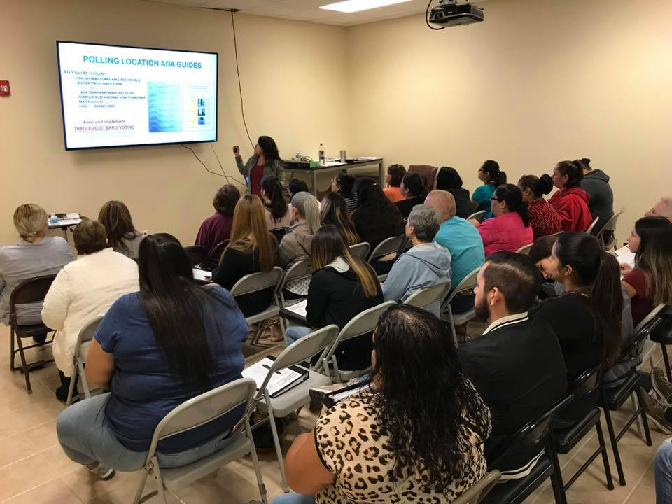
Develop & Implement:
Polling location Judge’s training:

Slide 17
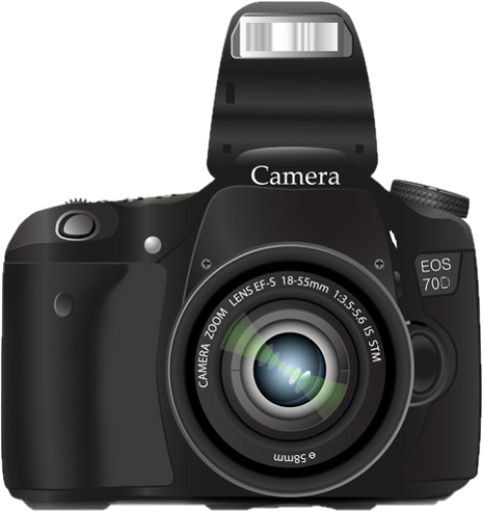
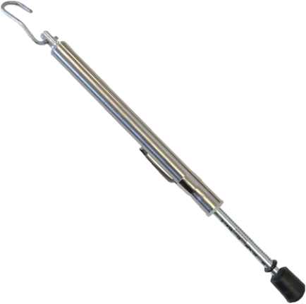
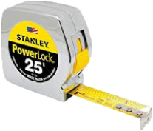
Surveyor Tool Kit:
June 2016 aDA Checklist for polling places
Pen/pencil & clipboard
Tape measure
Digital level
Door pressure gauge
Camera with flash

Slide 18
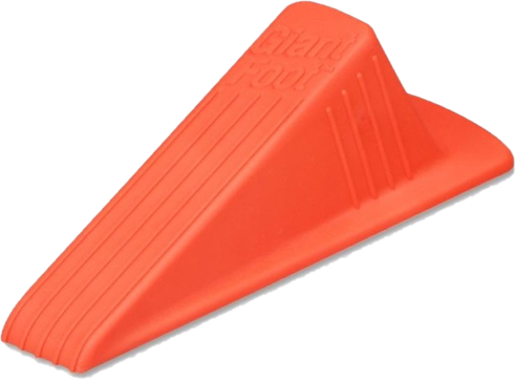
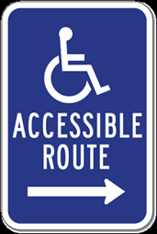
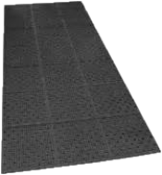
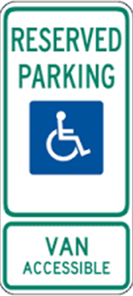
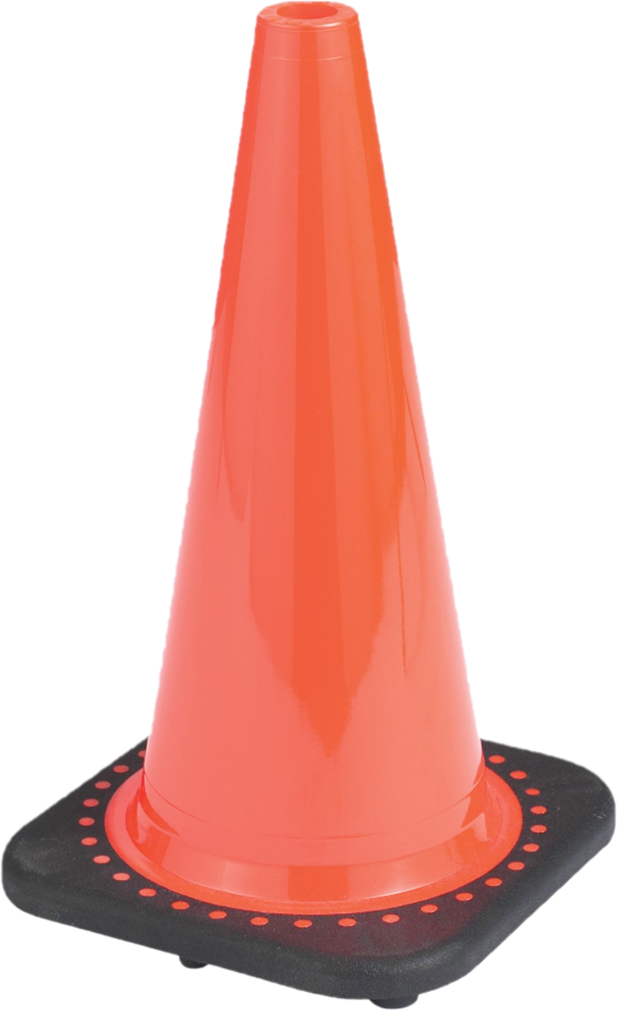
Temporary Measures & Curbside Tools:
ESSENTIALS
Traffic Cones
Mats:
Hard Plastic
Rubber Mats (Cut to Size)
Cone signs
Curbside Parking/Voting
Accessible Route
Reserved Parking
Rubber Thresholds
doorstops

Slide 19
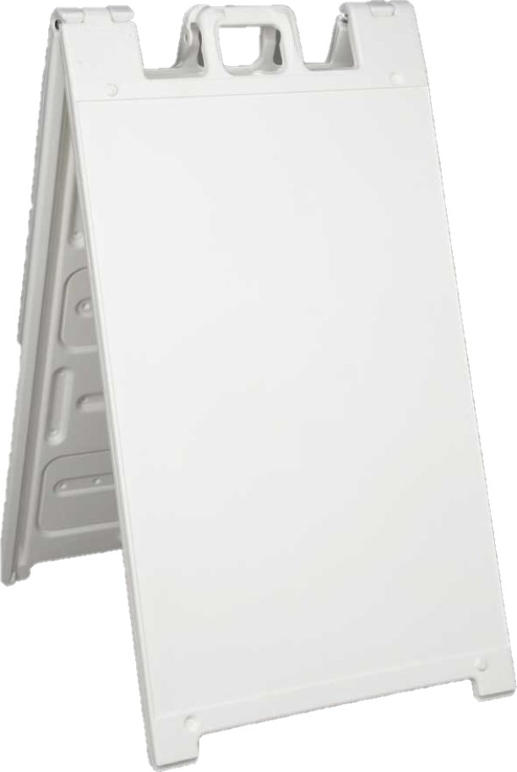
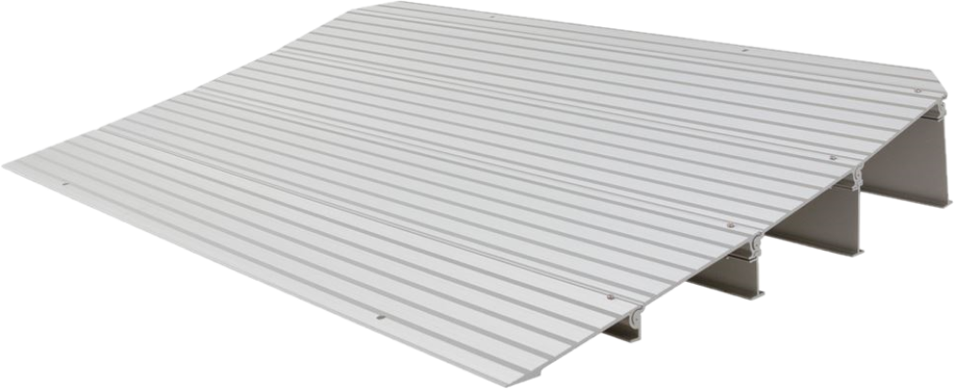
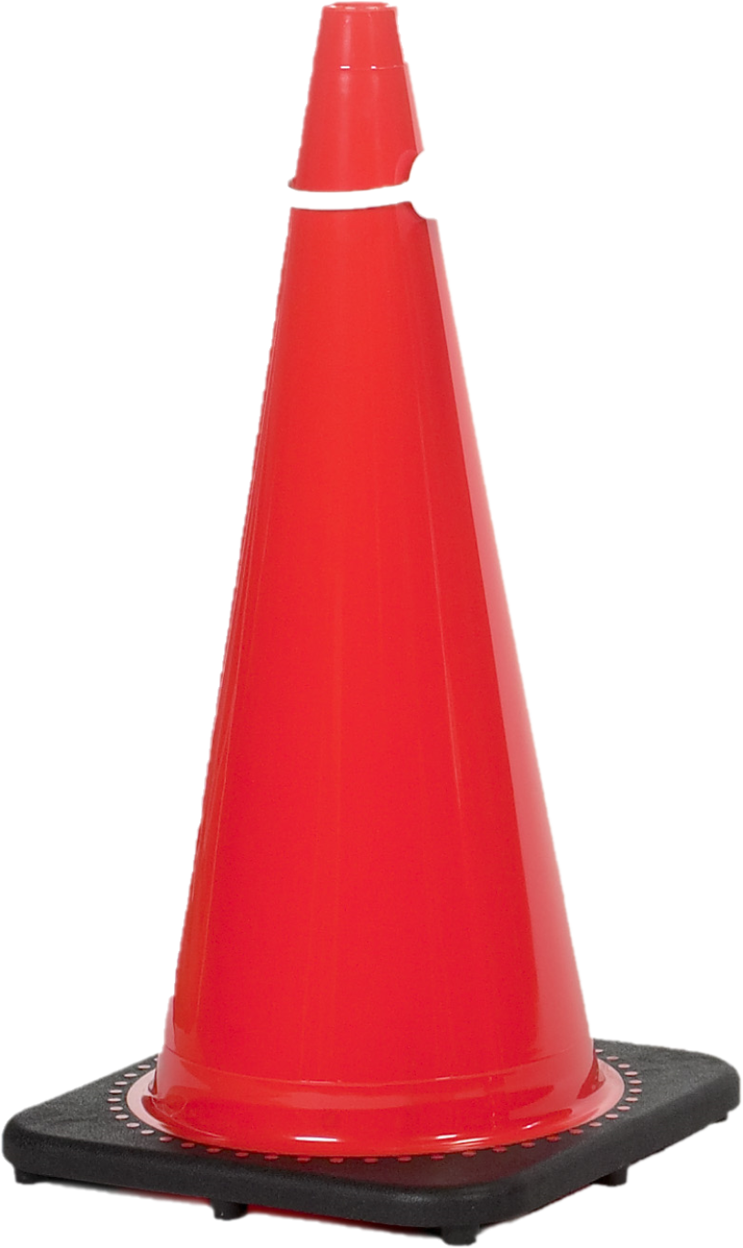
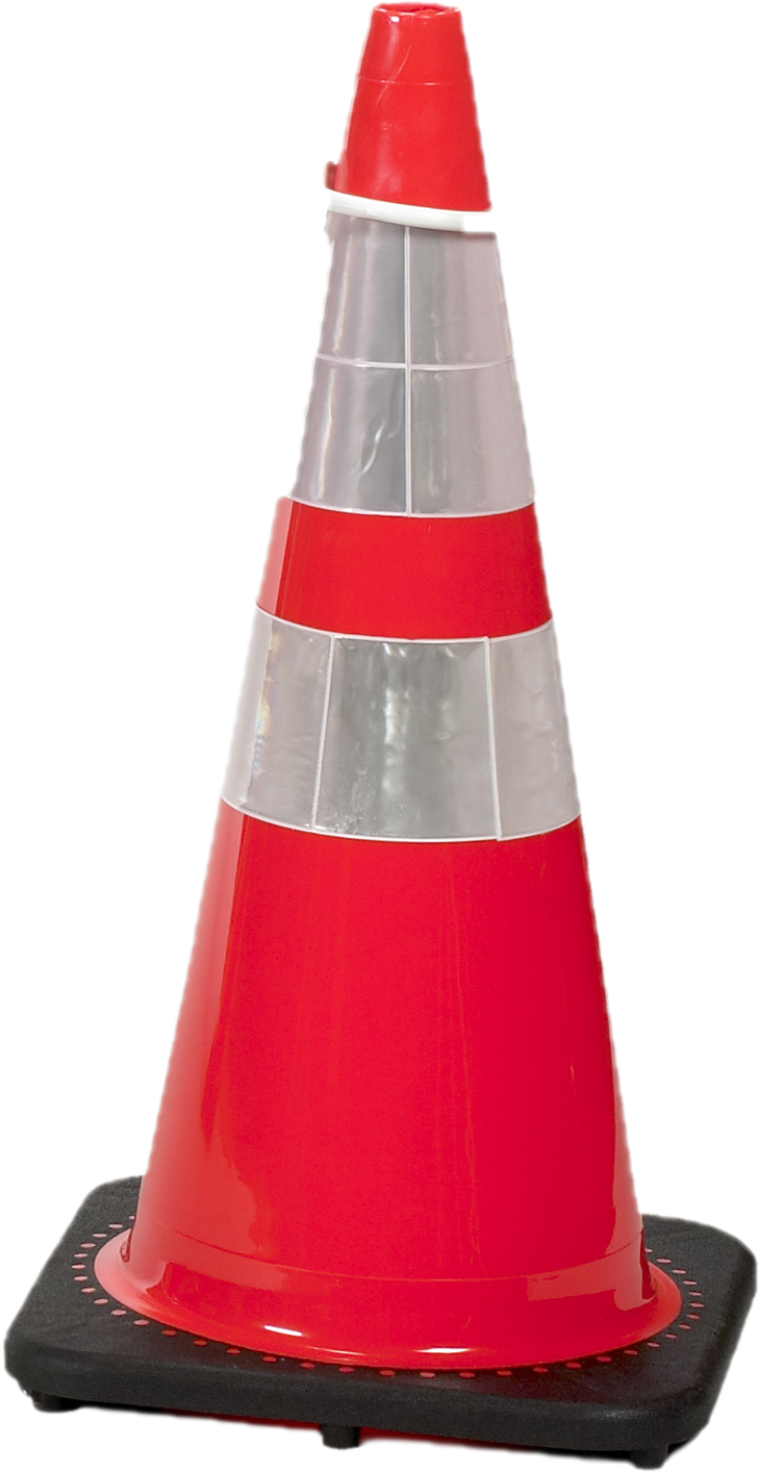
Temporary Measures & Curbside Tools:
ADDITIONAL
Cone bars
Metal ramps
A-frames
Curbside buzzers

Slide 20
Surveyor Department Workforce/Staffing:
Odd number years:
2 surveyors
2 surveyor techs
Even number years:
2 surveyors
4 surveyor techs

Slide 21
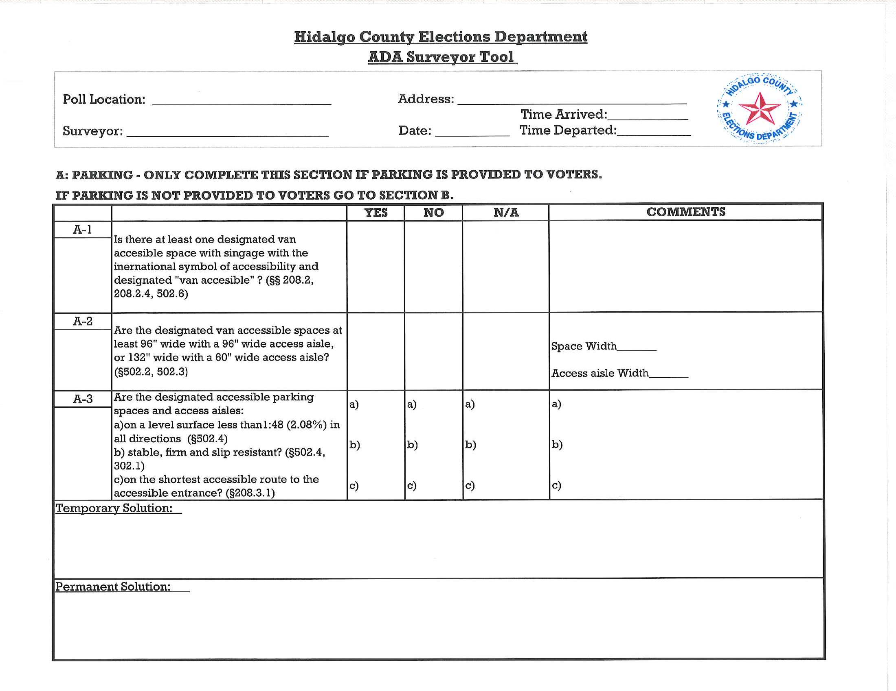
Surveyor Tool Temporary Measures:

Slide 22
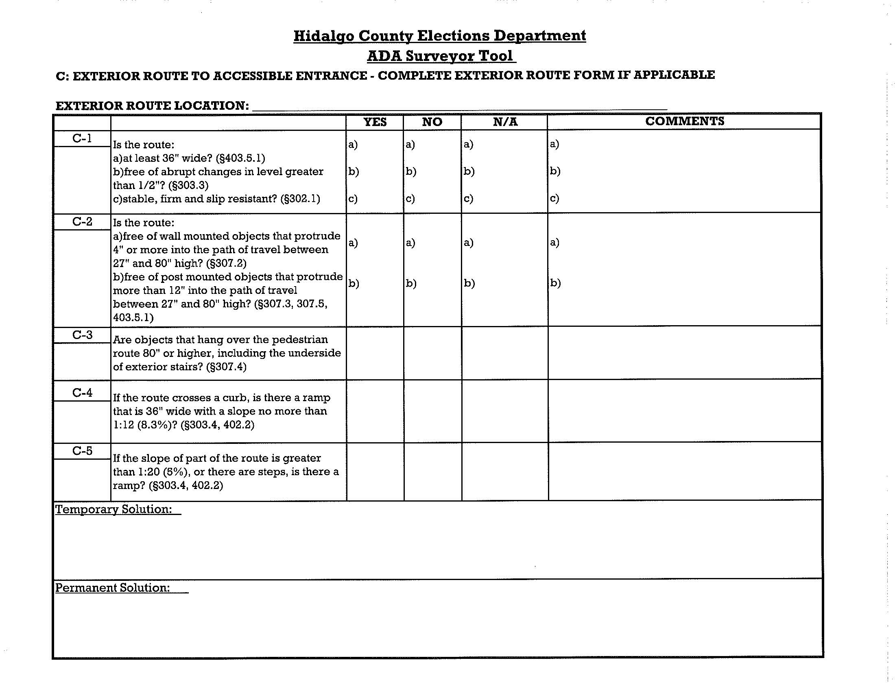
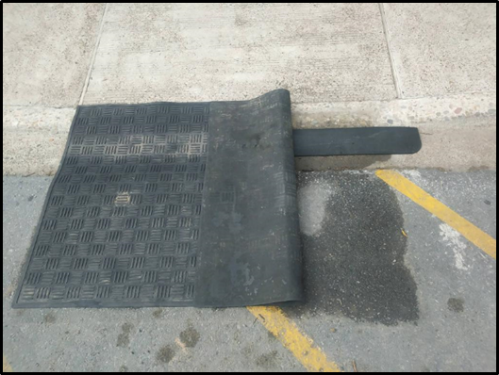
Surveyor Tool Temporary Measures:

Slide 23
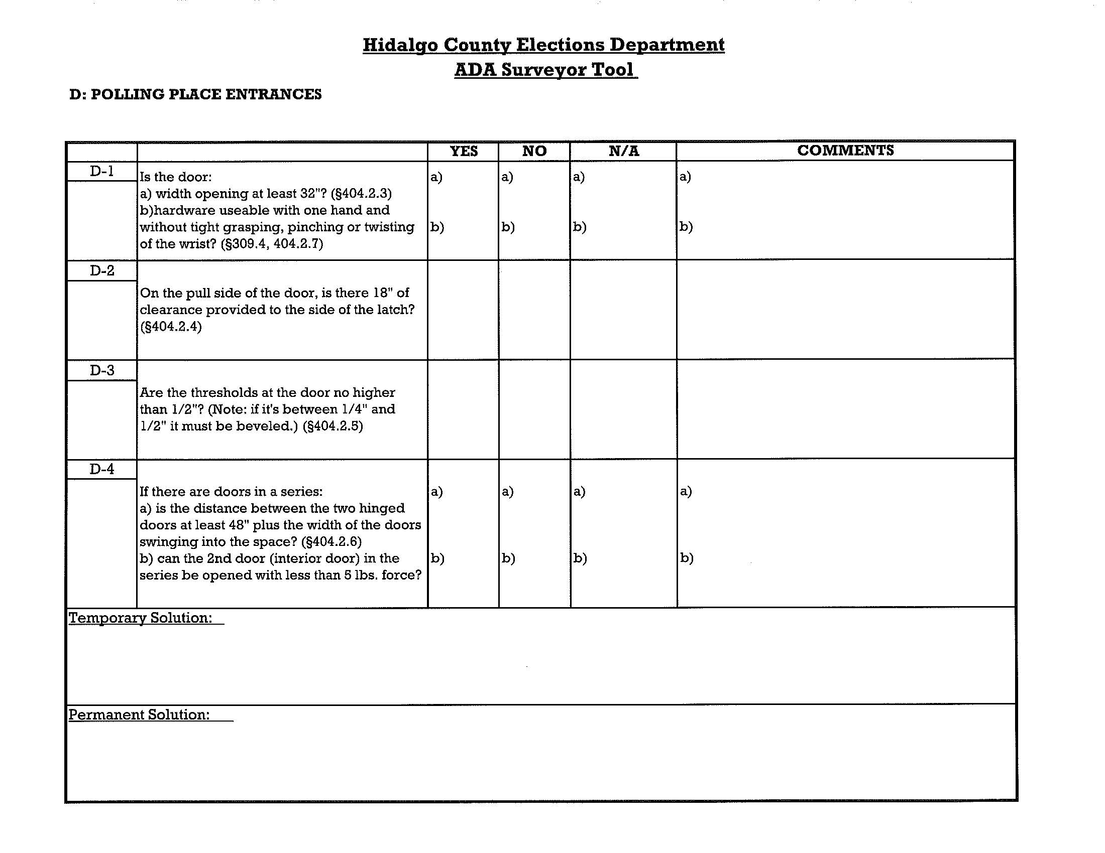
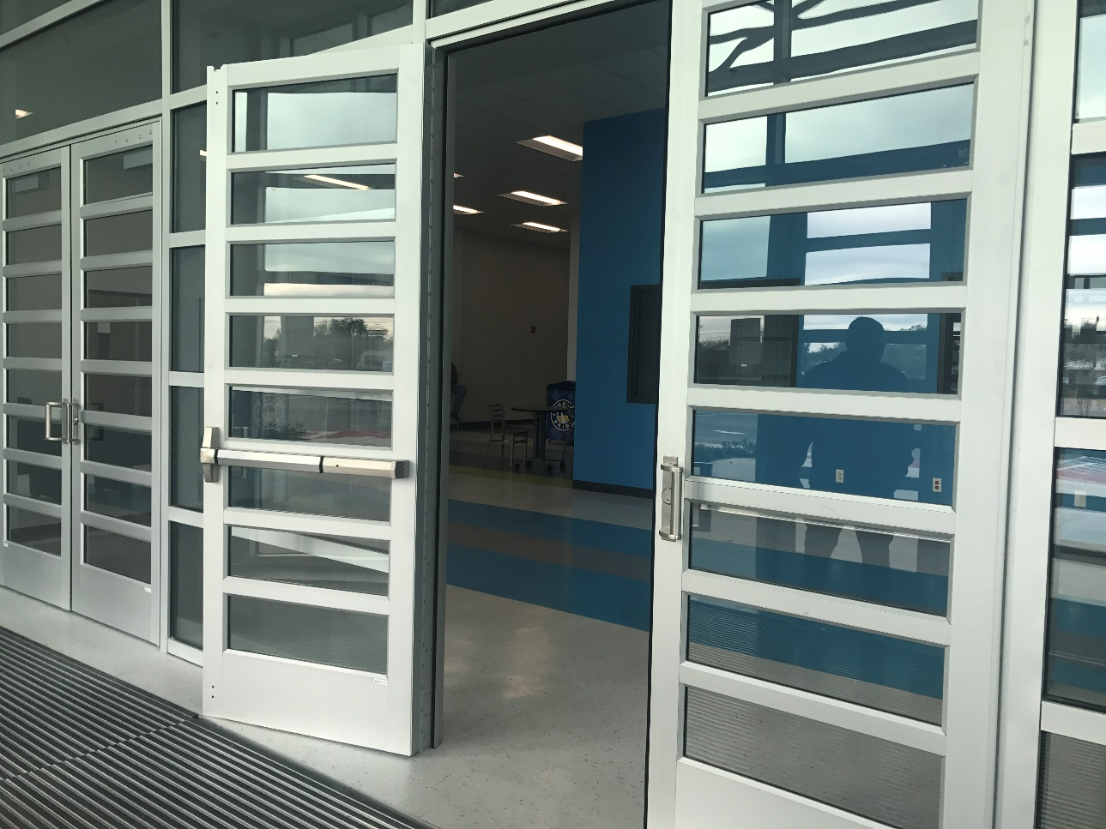
Surveyor Tool Temporary Measures:

Slide 24
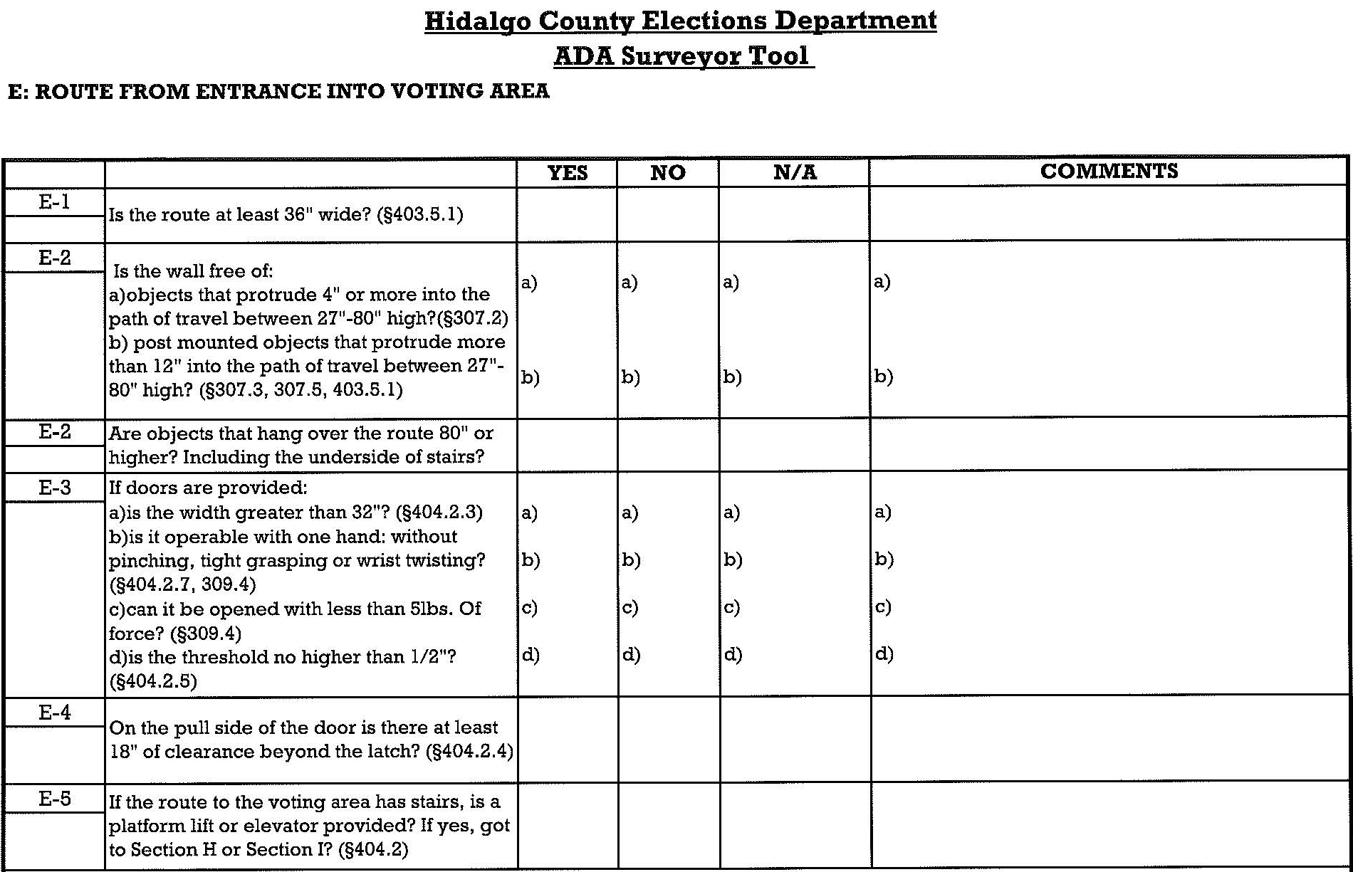
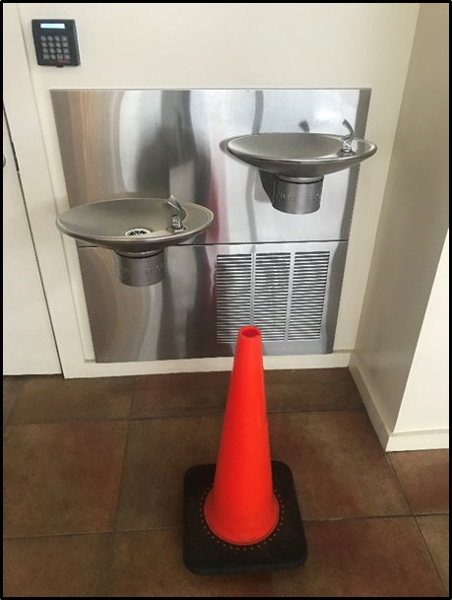
Surveyor Tool Temporary Measures:

Slide 25
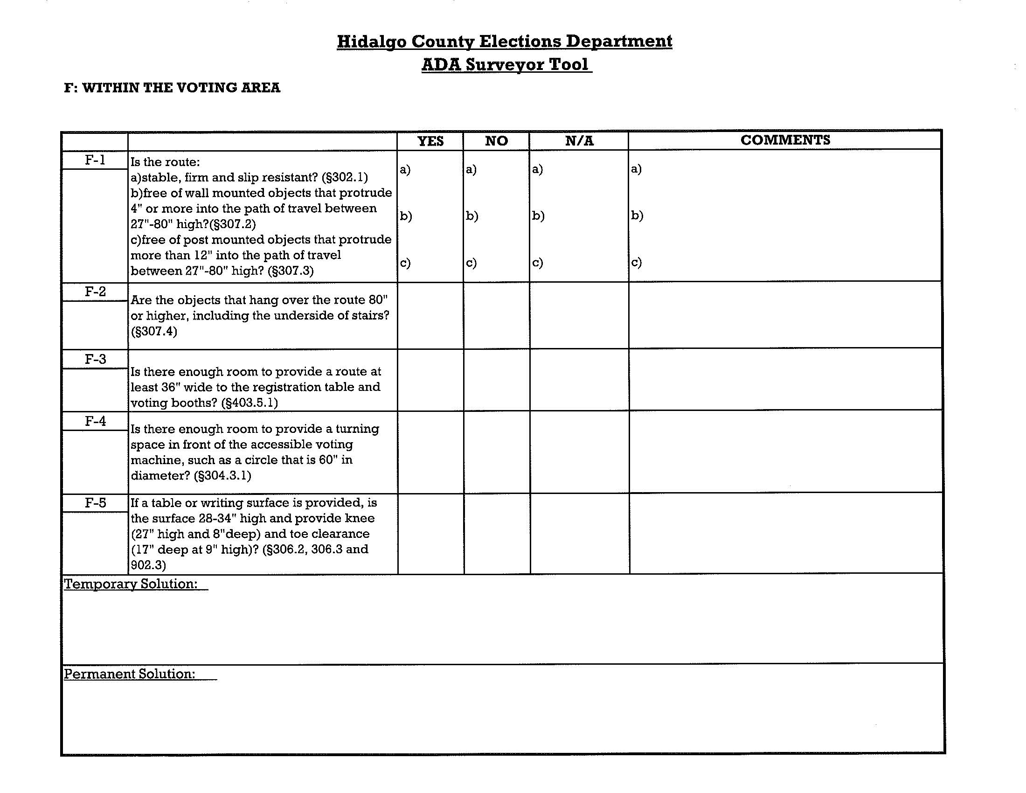
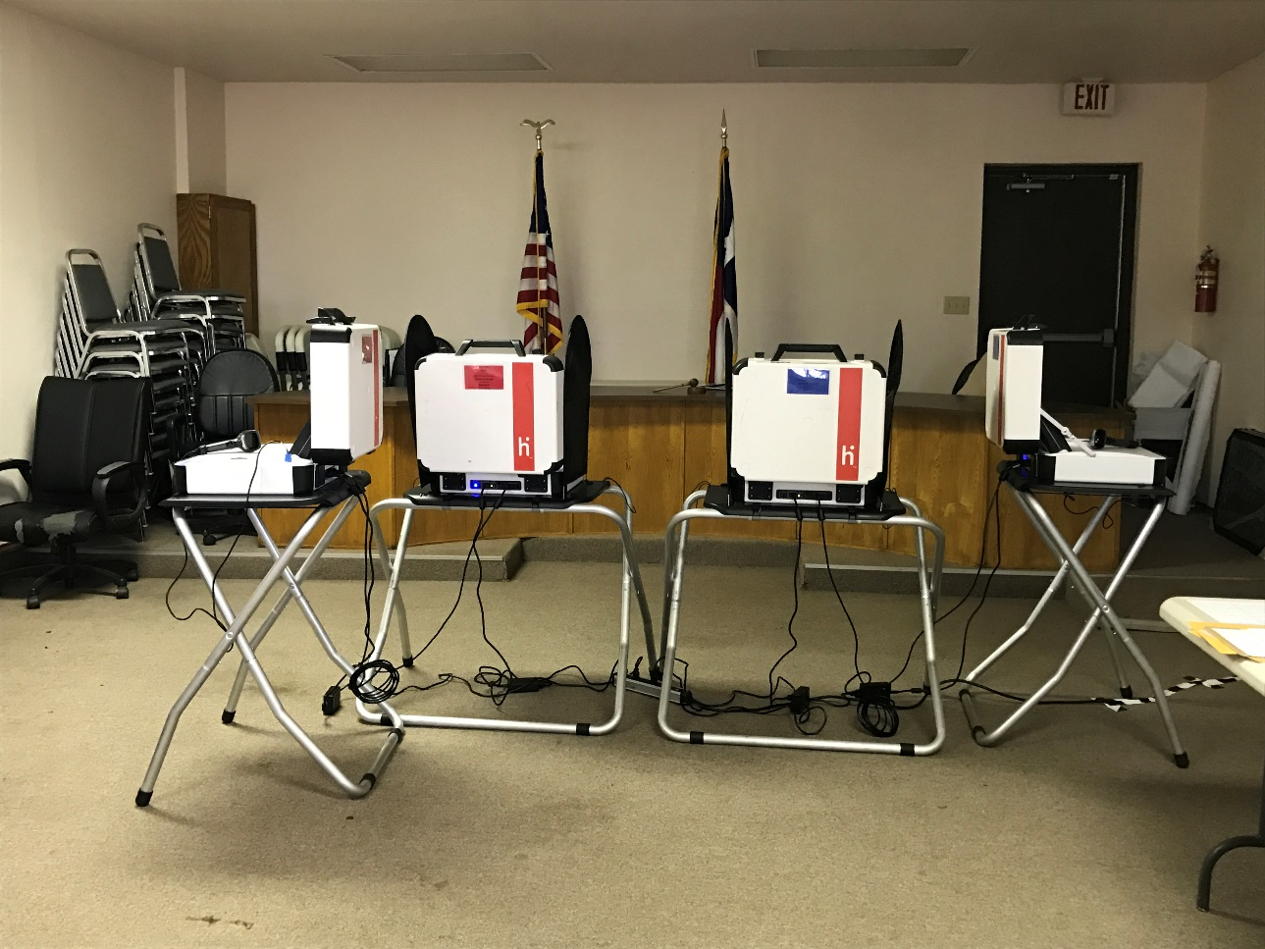
Surveyor Tool Temporary Measures:

Slide 26
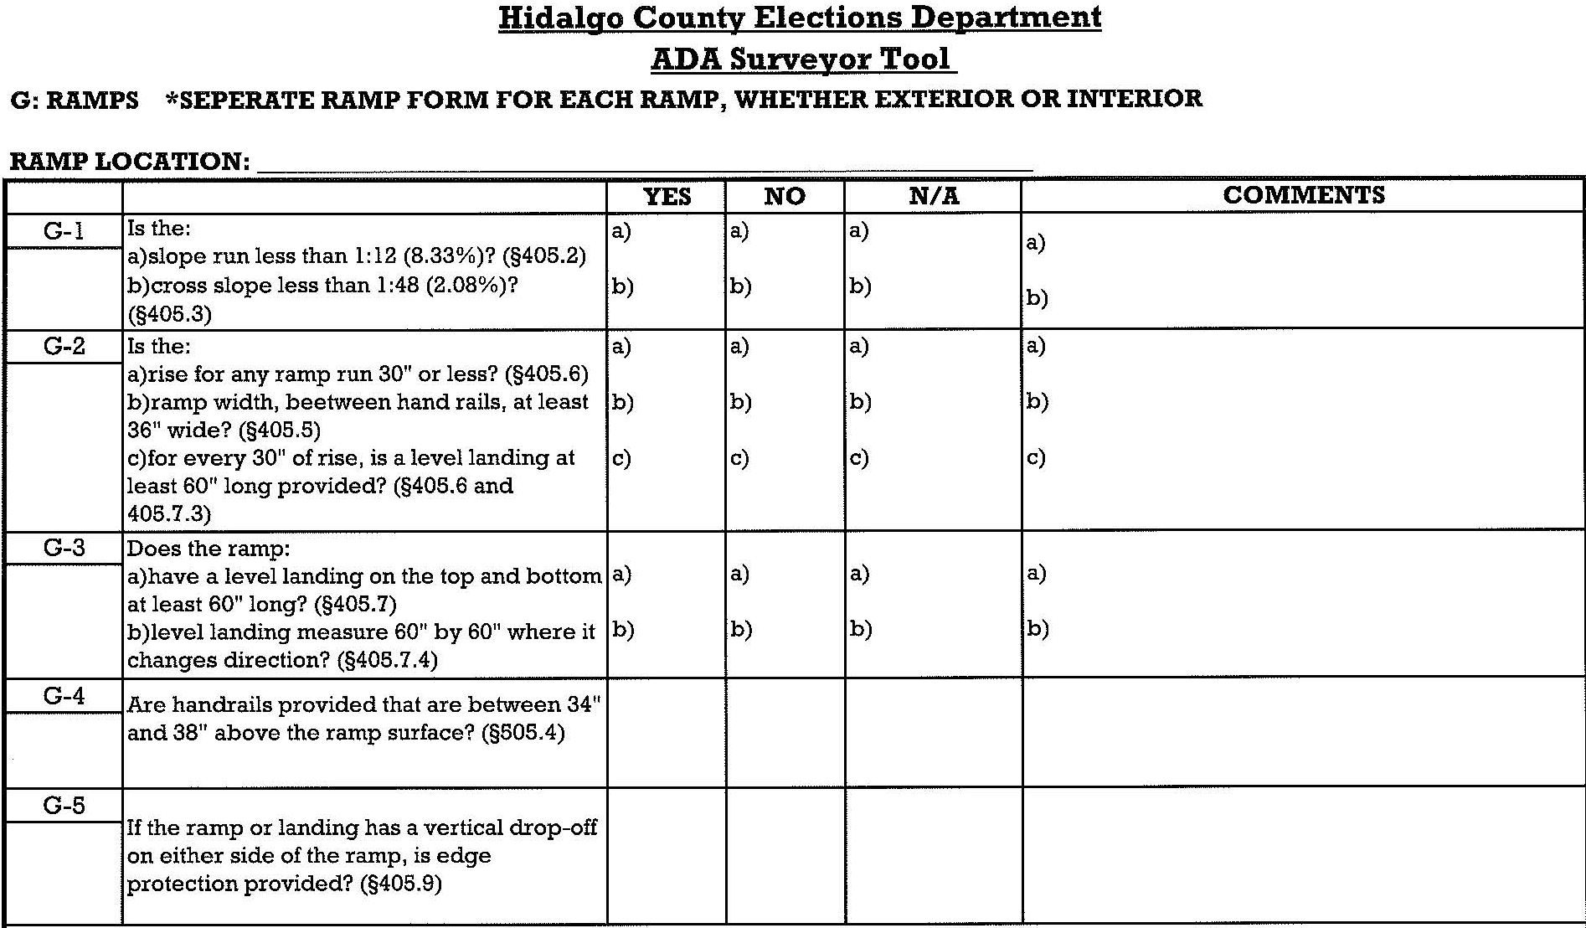
Surveyor Tool Ramp Structural Changes:

Slide 27
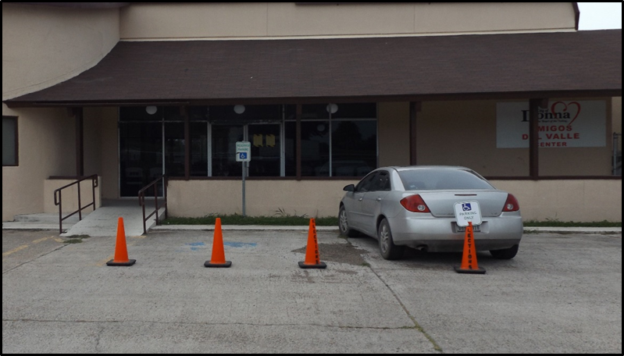
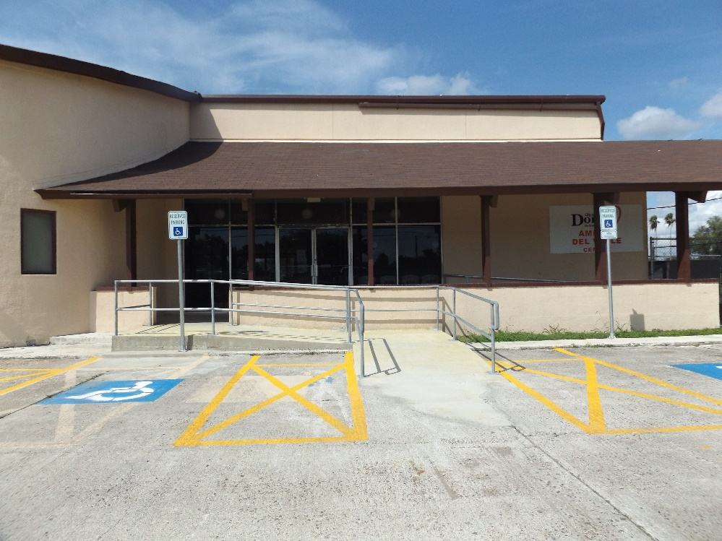
Surveyor Tool Ramp Structural Changes:
Before:
after:

Slide 28
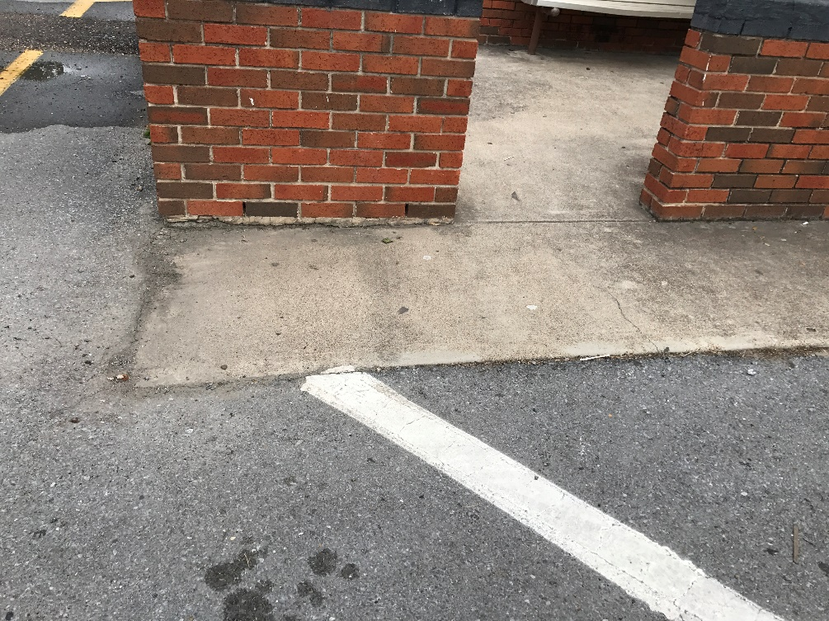
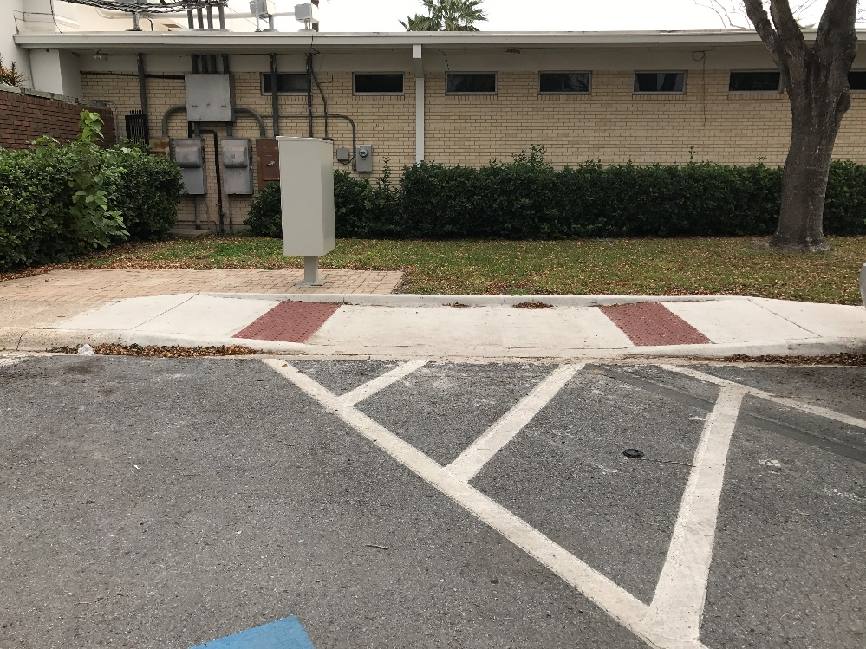
Surveyor Tool Ramp Structural Changes:
Before:
after:

Slide 29
Review: 2016 to Present
2016 ELECTION DAY:
53 locations SURVEYED BY DOJ
FULLY ACCESSIBLE: 14
NOT COMPLIANT: 39
TEMPORARY REMEDIABLE: 35
STRUCTURAL CHANGES: 4
2020 ELECTION DAY (projected):
74 countywide polling locations
FULLY ACCESSIBLE: 73
FULLY COMPLIANT: 47
TEMPORARY REMEDIABLE: 35
NOT COMPLIANT: 1
STRUCTURAL CHANGES
UNDERGOING EVALUATION

Slide 30
Resources:
ADA checklist for polling places
https://www.ada.gov/votingck.htm
Entity point of contact
City Secretary/ Superintendent/ Asst. Superintendent
Entity Director of Facilities/ Public Works
Opportunity & partnership with u.s. Department of justice
Houston Civil Rights Contact Info:
Jimmy Rodriguez
Office: (713) 567-9532

Slide 31
Hidalgo County Elections Surveyor Department
Contact Info:
Main Office: (956) 318-2570
Eberto Gauna, surveyor II:
eberto.gauna@co.hidalgo.tx.us
Ext. 5730
Diana Zapata, Surveyor I:
diana.zapata@co.hidalgo.tx.us
Ext. 5738
Cindy Lopez, elections specialist:
cindy.lopez@co.hidalgo.tx.us
Ext. 5729

